Slide 1
Process Mapping 101
How to map your procurement process to reduce cycle times
INSTRUCTIONS: this deck is a resource you can review at your own pace that covers the mechanics of process mapping and how it can be a tool for your procurement transformation efforts. The appendix includes sample slides and notes to use to hold your own process mapping session.
Notes:
PHOTO SOURCE: https://www.6sigma.us/kaizen/what-is-a-kaizen-process-mapping-event/

Slide 2
Agenda
Understanding and Building a Process Map: What is a process map? How can it be a tool to accurately capture my procurement processes?
Let’s Practice Mapping! What are the steps to capture in a hypothetical scenario? How might I apply this approach in my jurisdiction?
Moving from Documentation to Change: How do I use my process map to diagnose and solve procurement efficiency challenges?
Appendix: sample slides for leading an initial process mapping session in your government

Slide 3
Understanding and Building a Process Map

Slide 4
Efficiency is the foundation for procurement transformation.
A confusing, burdensome procurement process can crowd out important strategic thinking about what outcomes a contract should achieve.
A bad process looks like…
But a good process could mean…
Excessive rounds of review and administrative requirements.
Unclear role delegation between purchasing, program, and legal staff.
Inconsistent process steps.
Frustrated vendors, especially among those firms that haven’t mastered your process!
Less time spent on administration and more time on strategy and planning.
A clear set of steps that everyone understands.
The right inputs from the right people at the right time.
An operation that values vendors and their experience.
But you can’t propose impactful process fixes without
accurately diagnosing the problems!

Slide 5
Process Mapping: A Powerful Diagnostic Tool
What is a process map?
A diagram that visually displays a series of steps that occur within a given process, often used as a tool in continuous improvement efforts. Each step includes the people involved and the resources required.
How can it be used?
Gather information. Generate consensus. Reduce waste. Design a new process or improve upon an existing one. Facilitate prioritization or strategic alignment. Identify gaps or overlaps.
Notes:
PHOTO SOURCE: https://www.ariscommunity.com/process-mapping

Slide 6
Why does process mapping matter?
Beyond helping us simply understand processes, process mapping can further other important goals for purchasing offices, such as:
Securing buy-in on process improvement and elevating the strategic importance of procurement by bringing key stakeholders together and collaboratively identifying slowdowns and roadblocks.
Identifying areas of confusion, or misunderstandings of policy that can be addressed through better communication and guidance.
Communicating with the public and vendors about procurement processes and demystifying procurement.
Remember: your first process map will depict current reality, NOT an ideal state.

Slide 7
What form does a process map commonly take?
Typically, a process map is a flowchart: a series of shapes and arrows that signify different types of steps in the process. It moves from left to right and each shape identifies an actor and what action that person takes.
Rules of Thumb
Reads from left to right. Boxes = steps in a process. Diamonds = decisions (yes/no, if/then). Set clear actors for each box: X does Y. Don’t get caught on exceptions to the rule. Focus on what is usually the case. Remember: give the 30,000-foot level of detail, not the microscopic level!
Notes:
PHOTO SOURCE: https://www.ariscommunity.com/process-mapping

Slide 8
Flowchart Notation in Practice
Boxes are steps in the process
Diamonds are decision points
Who
+
Verb
Yes
<Question or Decision>
No
Who
+
Verb
Arrow
represents direction of flow
“Terminator” (oval)
represents the start and end point(s)
Who
+
Verb

Slide 9
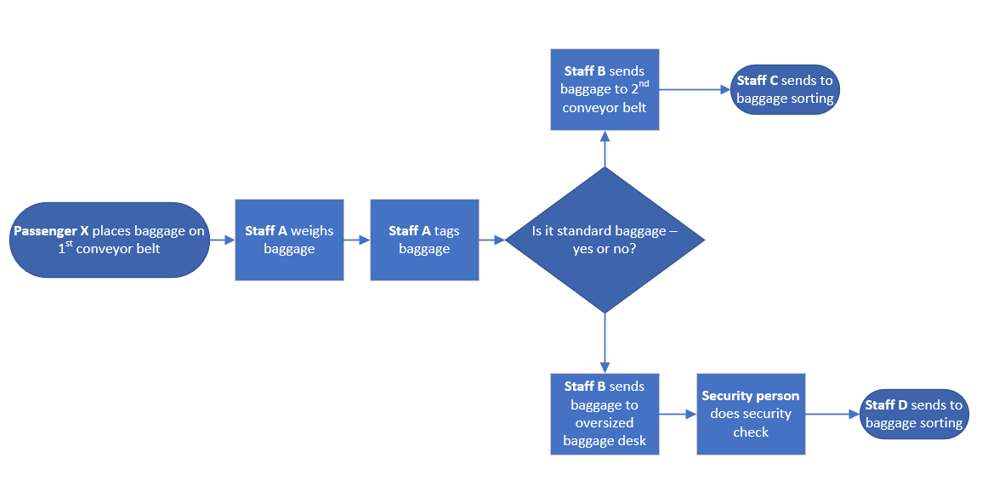
Flowchart Example: Airport Baggage Handling
We’ve seen governments use Microsoft Visio, Miro, and Lucidchart to formalize their process maps into a flowchart.

Slide 10
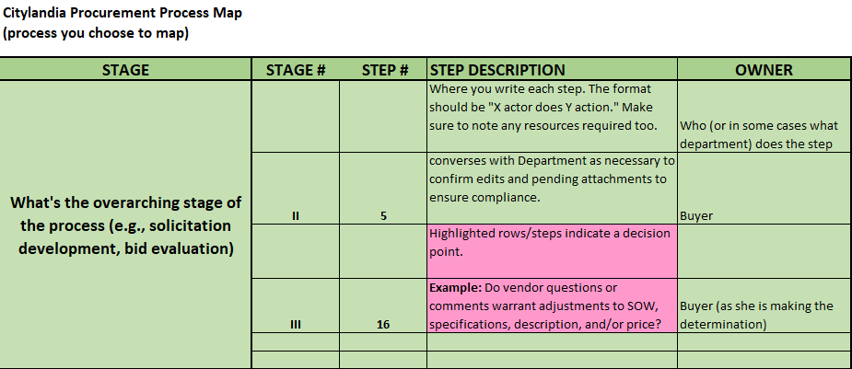
Is a flowchart the only way to draw a process map?
Not at all! Spreadsheets are another format to consider, especially if you need to conduct your process mapping session virtually.
Rules of Thumb
Steps flow from top to bottom. Each row is a step. Highlighted rows are decisions. (Note: branching logic is a little harder to capture on a spreadsheet.) Columns can illustrate step order, step descriptions, and actors.

Slide 11
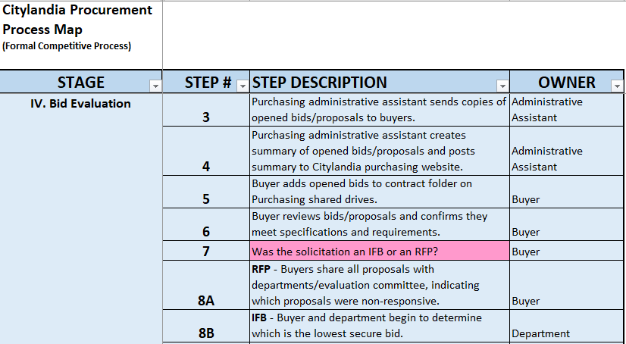
Spreadsheet Example: Bid Evaluation for Formal Contracts

Slide 12
Building a Process Map

Slide 13
An effective process map comes down to….
and
People
Preparation
Method
Let’s break it down into 3 steps.

Slide 14
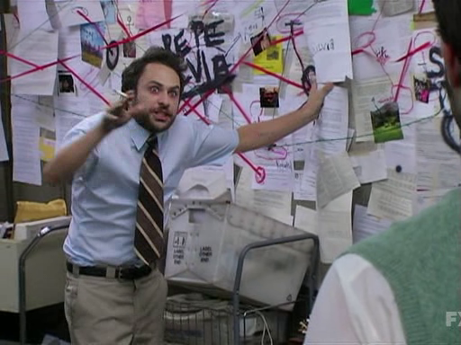
1. Determine the process(es) you want to map.
Every procurement operation contains multiple processes! Formal contracts, RFPs, informal purchases, p-cards…there are many places to start.
Consider starting with a process that has caused confusion or delays in your jurisdiction.
Longer or more complex processes will require mapping sessions.
We promise your process mapping endeavors won’t be this overwhelming!
Notes:
PHOTO SOURCE: https://www.pinatafarm.com/templates/charlie-day-meme

Slide 15
2. Include the right staff.
Stretch beyond your immediate team - including owners of process steps outside a central Purchasing office helps to build consensus and stakeholder buy-in.
Consider including customer departments, Legal, Finance and administration, City Clerk, and Data or IT
Don’t omit frontline staff - they often have a better understanding of how the process actually happens on the ground than managers.

Slide 16
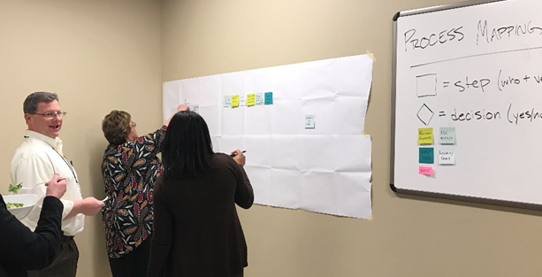
3. Create the process map with your colleagues.
Conduct your first process mapping session in a group setting with those that are most involved in the process. Hold multiple sessions, if necessary for complex processes.
Your first goal of this session(s) is to create a shared understanding of the process. Find out:
What steps are in the process
Who is responsible for each step
Quantify each step: number of days and resources associated with each step
Staff are busy, so craft a session that maximizes your time together.
A high-level outline of the process can jumpstart the session.
Following the session, gather missing information via one-off consultations with stakeholders.

Slide 17
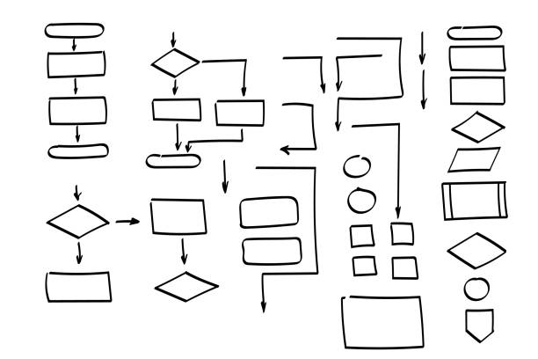
There are many ways to build a process map as a group.
Asking participants to first draft their own simple process maps, then have them compare with each other and your prepared process map.
Sketching it out on poster paper or a dry erase board.
Printing out a basic process map and asking participants to suggest edits and additional steps through different colored stickies.
Revise and add steps using a shared spreadsheet - an excellent choice for remote teams!
Notes:
PHOTO SOURCE (dry erase): https://www.grainger.com/product/QUARTET-Dry-Erase-Board-Wall-Mounted-48LW72
PHOTO SOURCE (poster board): https://www.amazon.com/Post-Sticky-Premium-Sticking-559/dp/B00006IA9F
PHOTO SOURCE (process map): https://www.istockphoto.com/vector/doodle-flowchart-shapes-doodle-symbols-pointer-icons-gm1272592355-374814124?phrase=hand%20drawn%20flow%20chart

Slide 18
Practice mapping on your own!

Slide 19
Build a sample process map
Practice the following task:
You are looking to buy a new vehicle in the next two months. You rely on this form of transportation for work and family obligations daily, so timeliness is critical. You have a budget of $10k.
On your own or with colleagues, map out the process of buying a new vehicle from start to finish.
Consider the following:
What steps must you take to complete the task?
How much time will you need for each step?
Who is involved? What are they responsible for?
What decision points will you hit?
Use poster paper as your base and sticky notes to indicate main steps. Be sure to show the connection points, decisions, and actors involved.

Slide 20
Flowchart Notation in Practice
Boxes are steps in the process
Diamonds are decision points
Who
+
Verb
Yes
<Question or Decision>
No
Who
+
Verb
Arrow
represents direction of flow
“Terminator” (oval)
represents the start and end point(s)
Who
+
Verb

Slide 21
Moving from documentation to change

Slide 22
Analyzing and solving challenges: step by step
Once you have finalized your process map, what are your immediate next steps? How can you use the map to bring about change over time? Start with developing staff buy-in and alignment around where to focus efforts.
Step 1: Analyze your process map and identify focuses
Step 2: Assess the risks and obstacles to change
Step 3: Pilot process changes
Step 4: Share, communicate, and engage staff from across your organization

Slide 23
Step 1: Analyze your process map
Working with the stakeholders you engaged to draft your initial process map, review each step and draw out the major pain points.
Ask yourself and others:
What’s excessive? Are there rounds of review or due diligence efforts that take more time than they’re worth? Are there too many steps given the importance of one sub-activity?
What seems missing in this process? Are there steps we can loop in to make our process more proactive, strategic, or value-add?
Are things being done consistently? Are there major discrepancies in whether steps are always followed? Do some people often skip certain steps?
Does this process include the right people? Are there staff we can better incorporate into the process, or incorporate them earlier?

Slide 24
Step 1: Analyze your process map
As you evaluate each step, consider what changes you can make to improve it.
Non-value add steps: lengthy, repetitive, unnecessary tasks that take away from the final product.
No use in keeping something that’s not helping your final product. This alone can reduce cycle times and increase efficiency.
CUT
Value-add steps: improve the quality and accuracy of the final product.
Help people continue pursuing these actions. As necessary, write guidance documents or trainings to cement best practices.
FORTIFY
Gaps in service: important strategic, compliance, and/or engagement efforts that are not being done.
If you realize important needs are not being met by the current process, propose and build new steps and processes in collaboration with government colleagues.
BUILD
Poor task delegation: staff are unclear who is responsible for what or people work on the wrong things.
Adjust who is assigned to which parts of the process and communicate these changes with stakeholders accordingly. Teams and individuals should work on what best taps into their experiences and expertise.
RESET

Slide 25
Step 2: Assess obstacles to change
“Every system is perfectly aligned to achieve the result it gets.” Changes will affect the stakeholders in your procurement process, and you may need to overcome resistance.
Remember that the idea of change is disruptive. Changing processes will change people’s jobs and their experience at work. It may even feel like they’re losing something important to them - even if from the outside it just looks like you’re eliminating a redundant step!
How do we overcome this?
Understand Competing Commitments. Government staff have many responsibilities, values, and conflicting goals.
Lead with Empathy. Even when the rational argument for change is clear, stakeholders’ fears and feelings need addressing.
Develop Sustainable Solutions that are adaptable to an evolving environment over quick technical fixes.

Slide 26
Step 3: Pilot changes
Piloting changes is an excellent way to demonstrate the impact of process improvement and build momentum for implementation with government partners.
Where might you want to pilot a new process change? Sometimes it’s helpful to start small. Consider:
Starting with 2-3 smaller changes, rather than taking on everything at once.
Testing with specific procurement or commodity types.
Testing in a specific office, department, or agency.
Think about how you can frame or talk about your pilot in ways that overcome reluctance and resistance.
We’re really excited to pilot this streamlined RFP approval process with the Dept of Sanitation! Here’s our rollout plan and instructions for staff.
I’m interested, but nervous about this new process - what if it makes our jobs harder?
That’s exactly why we’re piloting it! We’ll learn from this pilot, get your feedback, and make changes if we need to.

Slide 27
Step 4: Share, communicate, and engage
Don’t overlook the importance of communication throughout your process improvement journey. Identify a few key moments to share information within and outside your department or office.
Share your process map and other resources. It offers a clear description of the steps of the procurement process and valuable data on cycle times and roles.
Highlight the changes you’re piloting. Talk about the changes you’ve made and offer suggestions for how other teams could adopt similar fixes.
Seek feedback. Talk to the managers and frontline staff implementing process improvements, and modify your plans based on their experiences.
Train others. Build trainings that help staff in other departments or offices replicate your successes.

Slide 28
You also have a great set of potential data for performance management and evaluation.
Cycle times: how many business days does the procurement process take? Which stages of the process take the longest to complete?
Keep in mind this is only feasible to collect if you have clear timestamps for the start/end points for different stages of the process.
Staff time is money, so you can also assess which steps or stages cost the most to pursue! Multiply the estimated hours spent by the hourly rate(s) of staff that work on that part of the process.
Flow: how many procurements do we process each year or quarter? How does that breakdown differ by solicitation type (ITB, RFP) or product/service?
Role delegation: What department or staff member “owns” the most steps? Who are most crucial for each stage of the procurement process?

Slide 29
Appendix: sample slides for leading an initial process mapping session in your jurisdiction

Slide 30
Building a Process Map for the [insert procurement process]
[Jurisdiction] - [Month 00, 0000]
Notes:
PHOTO SOURCE: https://www.6sigma.us/kaizen/what-is-a-kaizen-process-mapping-event/

Slide 31
Icebreaker
If a bullet, shape, or text box is highlighted in orange, that means you should change the text to adapt to your jurisdiction’s needs. All other text you can keep as is! (And delete this box, of course.)
Your name
Role at the city
A fun question that you can pose to the small group to create a relaxed but engaged brainstorming environment. Some examples below:
Favorite ice cream flavor
Where you want to visit next on vacation
Favorite park in the city, state, or district
Best gift you’ve given or received
Notes:
ESTIMATED TIME: 5 minutes.
FACILITATOR’S NOTE: The goal here is to build rapport and familiarity with all the participants. Make sure to not take more than 5 minutes here.

Slide 32
Our Goals for Today
Understand the usefulness of process mapping as a tool
Build a working process map for our procurement process
Walk away with a shared understanding of:
Steps in the process
Time and resources required in each step
Roles and responsibilities
Current pain points
Notes:
FACILITATOR’S NOTE: Don’t advance to the other slides until it seems like everyone understands the goals. Feel free to prompt any questions: “Does anyone have any questions about this?”
PHOTO SOURCE: https://www.freepik.com/premium-vector/archery-target-with-arrows-semi-flat-color-vector-object-full-sized-item-white-participating-competition-simple-cartoon-style-illustration-web-graphic-design-animation_26133668.htm

Slide 33
Norms for Discussion Today
Step in, step back
Scenarios and themes over names and departments
Limit cell phone use or laptop use during the meeting. Listen when others contribute
Stay muted unless speaking.
Indicate when you would like to speak using the chat box OR the “raised hand feature.”
Feel free to adjust these highlighted bullets based on your team and format.
Notes:
PHOTO SOURCE: https://www.cumanagement.com/articles/2019/12/nextgen-know-how-framework-better-shorter-meetings
FACILITATOR’S NOTE: Emphasizing these norms is critical, as you don’t want this group session to devolve into a complaint hour! Make sure that participants really understand that this discussion is a safe space for honest discussion around what works and what doesn’t.
FACILITATOR’S NOTE: “Step in, step back” means encouraging everyone to speak, but not letting any singular voice or perspective dominate discussion.

Slide 34
Process Mapping: A Powerful Diagnostic Tool
What is a process map?
A diagram that visually displays a series of events or steps that occur within a given process, often used as a tool in continuous improvement efforts. Each step includes the people involved and the resources required.
How can it be used?
Gather information. Generate consensus. Reduce waste. Design a new process or improve upon an existing one. Facilitate prioritization or strategic alignment. Identify gaps or overlaps.
Notes:
PHOTO SOURCE: https://www.ariscommunity.com/process-mapping

Slide 35
Today’s Focus
The procurement process involves many steps and incorporates many contract types. For our session today, we will focus on the procurement process for formal contracts. This means that we are only focused on X activity.
Today’s focus
Procurement Planning
Formal Contracting Process
Contract Execution and Management
Notes:
FACILITATOR’S NOTE: Use this slide to specify which aspect of the process you’ll discuss in your meeting. We find the arrows a good graphic to use as it demonstrates how the process you are focusing on is part of larger systems of your jurisdiction!

Slide 36
Breaking Down the Formal Contracting Process
Procurement Planning
Formal Contracting Process
Contract Execution and Management
We will start here
We will end here, with executed contract
Preparing the Requisition
Creating a Solicitation
Bid Approval and Advertising
Bid Evaluation
Finalizing Purchase Order
Steps 1-9
Steps 10-18
Steps 19-29
Steps 30-40
Steps 40-53
Notes:
FACILITATOR’S NOTE: This is where it’s helpful to have a basic process map down in advance. You can throw out some initial stages and steps and use that as the basis of discussion. Again, this is all part of framing the discussion.
A stage is just a category or genre of steps, so don’t feel this staging/graphic has to be perfect. It’s just to give the participants a sense of how you’ll be framing discussion and the process.

Slide 37
How to Read a Process Map (Flowchart)
Today we’ll be using a flowchart: a series of shapes and arrows that signify different types of steps in the process. It moves from left to right and each shape identifies an actor and what action that person takes.
Rules of Thumb
Reads from left to right. Boxes = steps in a process. Diamonds = decisions (yes/no, if/then). Set clear actors for each box: X does Y. Don’t get caught on exceptions to the rule. Focus on what is usually the case. Remember: give the 30,000-foot level of detail, not the microscopic level!
Notes:
FACILITATOR’S NOTE: Only use this slide if you are asking folks to work off a basic shape-based process map. Make sure to not advance until everyone understands the “rules of thumb.”
PHOTO SOURCE: https://www.ariscommunity.com/process-mapping

Slide 38
Flowchart Example: Airport Baggage Handling

Slide 39
How to Read a Process Map (Spreadsheet)
Today we’ll be building our initial process map using a shared spreadsheet.
Rules of Thumb
Steps follow from top to bottom. Each row is a step. Highlighted rows are decisions. (Note: branching logic is a little harder to capture on a spreadsheet.) Columns can illustrate step order, step descriptions, and actors.
Notes:
FACILITATOR’S NOTE: Only use this slide if you are asking folks to work off a spreadsheet process map. This will be new content for many people, so be sure to stop and ask for questions here.

Slide 40
Spreadsheet Example: Bid Evaluation for Formal Contracts

Slide 41
Building Out Our Process Map
Review the printed/spreadsheet process map and ask:
Does it cover all the tasks involved? Are we missing a step?
Do any steps require additional forms or approvals?
Have we correctly identified all parties involved (Purchasing, departments, Legal)? Does each step have a clear actor?
Have we correctly and adequately all the stages (collections of steps) in the process?
As you work on this, remember:
Each step should have a clear actor.
Simple is good. Only add steps to the process map if they are broadly applicable, not just one person’s preference. Don’t be too concerned with exact timelines.
Our objective is to capture the current reality, not the ideal state.
Notes:
ESTIMATED TIME: 10-15 minutes.
FACILITATOR’S NOTE: This activity can be done together, or ask folks to review the process map on their own before sharing out their thoughts.
FACILITATOR’S NOTE: If you’re doing this activity in person, incorporate 2-3 minutes to demonstrate how you would like participants to add feedback to the draft process map (stickies, pen/pencil).
FACILITATOR’S NOTE: Make sure to really emphasize these last few points: we’re looking at the current reality, NOT the ideal or your preferred one. You want something generalizable across all staff, not just true for a select few.

Slide 42
Reviewing and Confirming Our Process Map Together
Thank you so much for your feedback! Now that we have some comments and questions, let’s review the process map step by step.
For each step, we want to confirm:
Does it have a clear actor?
Does mention the required forms and resources?
Is it representative of the current reality (NOT the ideal)?
Is it a standard, required task of all procurements in this process?
And for the process overall, let’s consider:
Have we correctly and adequately included all the stages (collections of steps) in the process?
Have we correctly identified all parties involved (Purchasing, departments, Legal)?
Are there any areas of disagreement or misalignment?
It is FINE if we don’t get through everything today! We can organize a follow-up meeting(s) if necessary.
Notes:
ESTIMATED TIME: At least 45 minutes.
FACILITATOR’S NOTE: This will be the bulk of the meeting. Your objective for these first process mapping sessions is just to confirm on the steps of the process. THEN you can analyze each step and identify takeaways.
FACILITATOR’S NOTE: Let conversation flow, but make sure to not let anyone dominate discussion or anyone feel left out. Feel free to call on people directly.

Slide 43
Analyzing Our Process Map
Ok, now we have a confirmed process map. Well done! Now let’s review each step and ask:
Does this step work well (green), ok (yellow), or poorly (red)? Why?
How long does the task take (minutes, days, weeks)?
Is this step a repeat or very similar to a prior step? If so, why is this step necessary?
Notes:
You will likely need a separate, follow-up meeting to address this portion of the process mapping process. That’s fine! This work takes time.
PHOTO SOURCE: https://www.stevenson.edu/online/about-us/news/origin-of-investigate
FACILITATOR’S NOTE: Again, don’t sweat it if you can’t reach this point by your first meeting. (It’s unlikely you will!) In fact, it may be more efficient to do exercise in a separate meeting.
FACILITATOR’S NOTE: See the next slide for a format you can use for assessing each step.

Slide 44
Analyzing Our Process Map
STEP Feel free to use the step number or describe the step. | Does this step work well? 3-point scale: green, yellow, red. | How long does it take? Feel free to use the step number or describe the step. | Is it a repeat of another step? Feel free to use the step number or describe the step. | NOTES
Example: Coordinator sends vendor initial contract and requests necessary signature, authorization documents and insurance forms. | Yellow | Usually, 2 weeks but can be a lot longer if the vendor is unresponsive. | No | This can be a lengthy process if there is a lot of back and forth between the vendor and the Coordinator.
Notes:
FACILITATOR’S NOTE: You can fill this out live in a slide like this, or use this same setup in a spreadsheet.

Slide 45
Debrief and Next Steps
How was that activity for you?
Next steps: [based on how far you got within the meeting, list next steps here]
Thank you so much for your time and hardwork!
Notes:
PHOTO SOURCE: https://www.sandiegouniontribune.com/news/religion/story/2020-11-22/celebrating-the-power-of-these-two-words-thank-you
FACILITATOR’S NOTE: Regardless of how much you accomplish in a given session, make sure to save 2-3 minutes to thank participants and setup next steps. A thank you goes a long way, as this can be taxing work!

